Slide 1

Lecture 8 Generative Models
CS5542

Slide 2
Overview
Unsupervised Learning
Generative Models
PixelRNN and PixelCNN
Autoencoders Variational Autoencoders (VAE)
Generative Adversarial Network (GAN)

Slide 3
Supervised vs Unsupervised Learning
Supervised Learning
Data: (x, y)
x is data, y is label
Goal: Learn a function to map x -> y
Examples: Classification, regression, object detection, semantic segmentation, image captioning, etc.

Slide 4
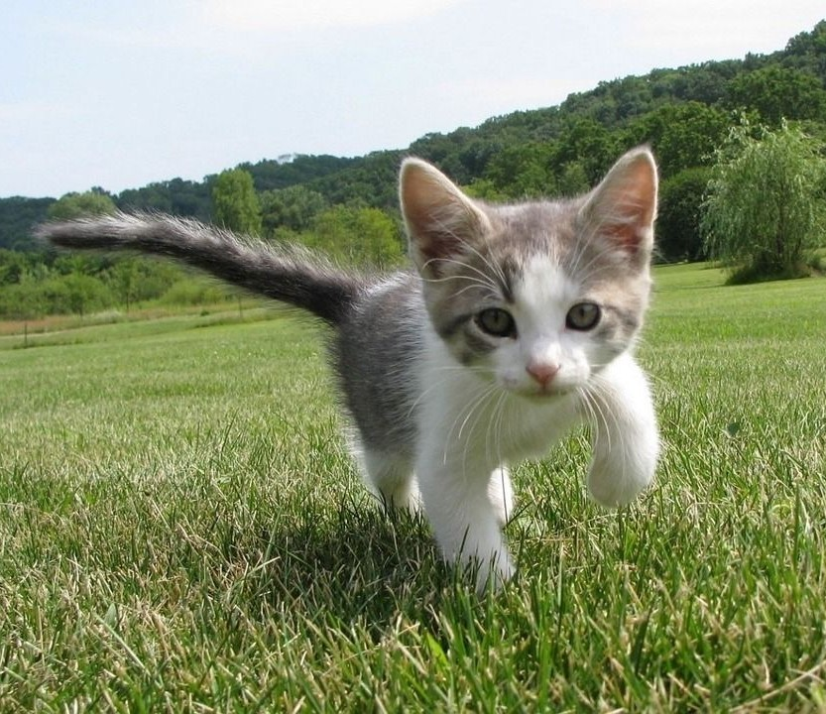
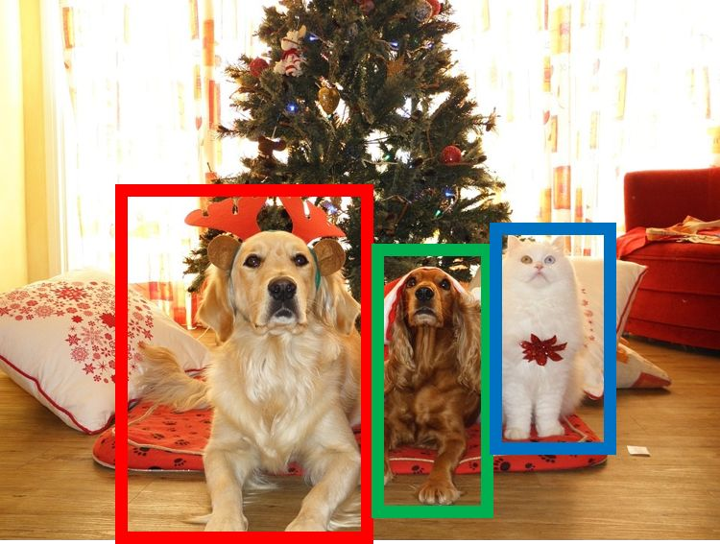
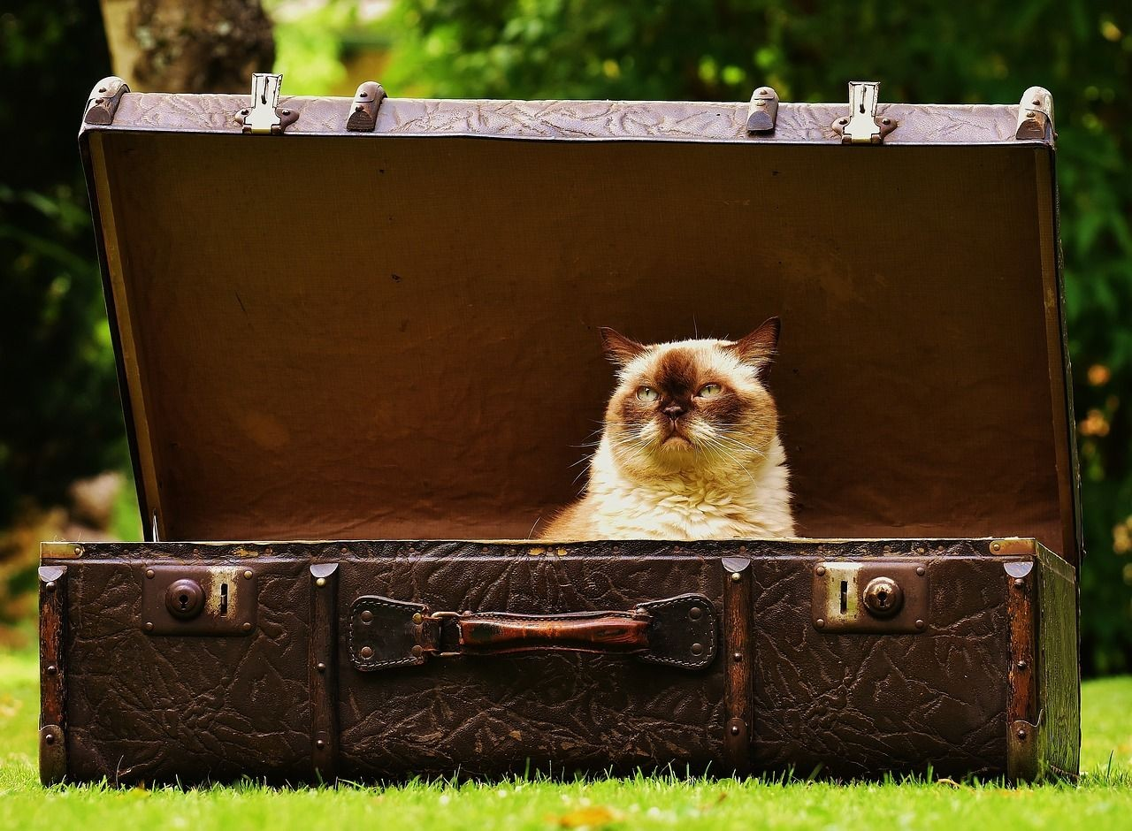
Cat
Classification
DOG, DOG, CAT
Object Detection
GRASS, CAT, TREE, SKY
A cat sitting on a suitcase on the floor
Semantic Segmentation
Image captioning

Slide 5
Supervised vs Unsupervised Learning
Unsupervised Learning
Data: x
Just data, no labels!
Goal: Learn some underlying hidden structure of the data
Examples: Clustering, dimensionality reduction, feature learning, density estimation, etc.

Slide 6
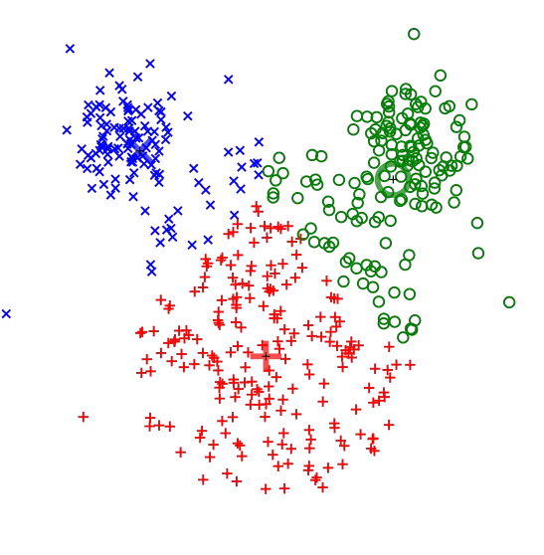
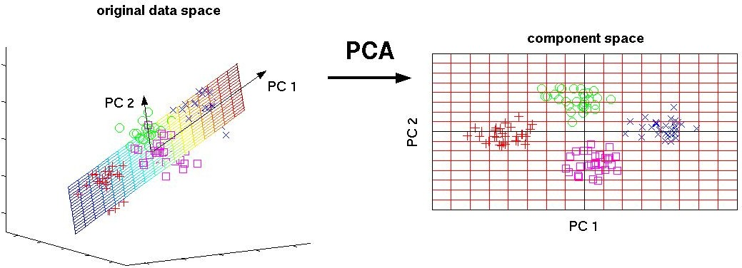
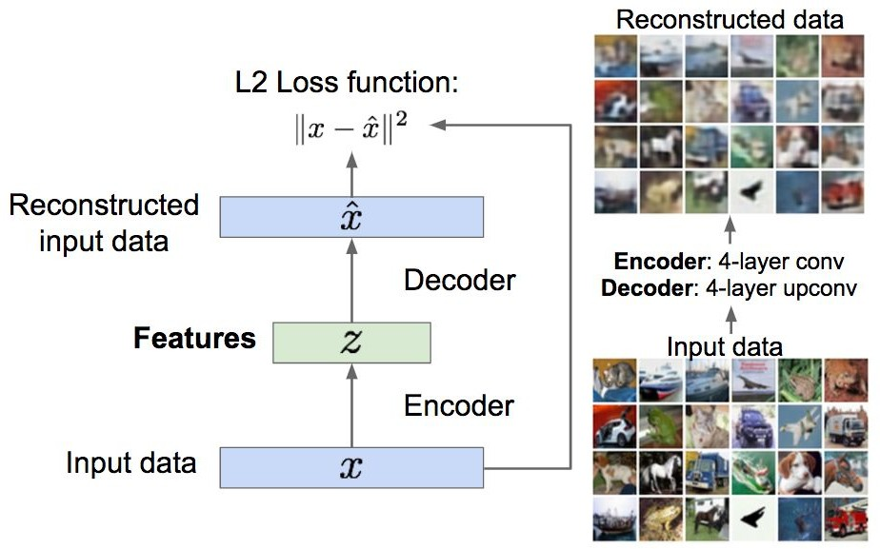
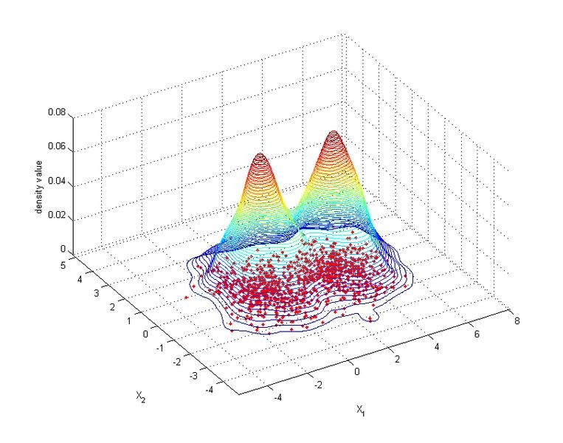
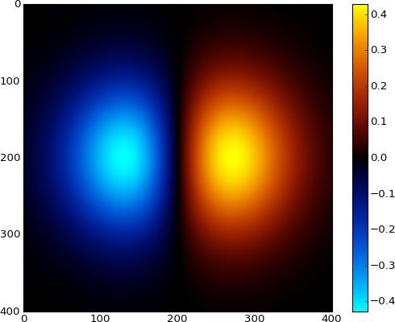
3-d 2-d
Principal Component Analysis (Dimensionality reduction)
K-means clustering
Autoencoders (Feature learning)
2-d density estimation

Slide 7
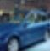
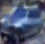
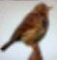
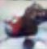
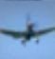
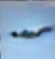
Generative Models
Given training data, generate new samples from same distribution
Training data ~ p_{data}(x) Generated samples ~ p_{model}(x)
Want to learn p_{model}(x) similar to p_{data}(x)

Slide 8
Generative Models
Given training data, generate new samples from same distribution
Training data ~ p_{data}(x) Generated samples ~ p_{model}(x)
Want to learn p_{model}(x) similar to p_{data}(x)
Addresses density estimation, a core problem in unsupervised learning
Several flavors:
Explicit density estimation: explicitly define and solve for p_{model}(x)
Implicit density estimation: learn model that can sample from p_{model}(x) w/o explicitly defining it

Slide 9
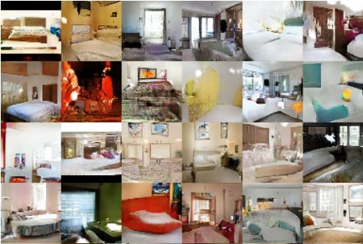
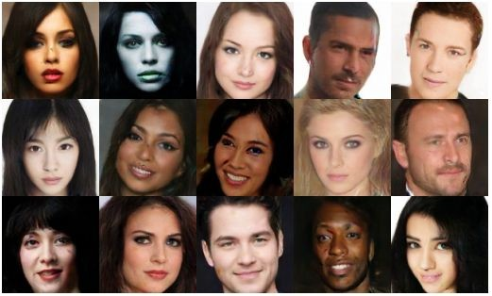
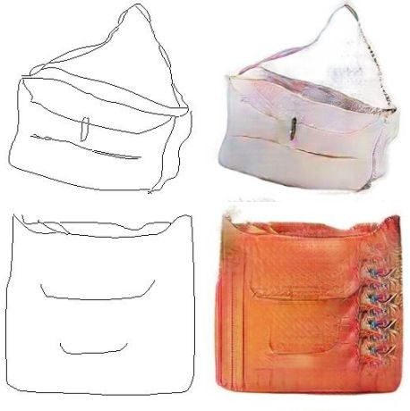
Why Generative Models?
- Realistic samples for artwork, super-resolution, colorization, etc.
Generative models of time-series data can be used for simulation and planning (reinforcement learning applications!)
Training generative models can also enable inference of latent representations that can be useful as general features
FIgures from L-R are copyright: (1) Alec Radford et al. 2016; (2) David Berthelot et al. 2017; Phillip Isola et al. 2017. Reproduced with authors permission.

Slide 10
PixelRNN and PixelCNN

Slide 11
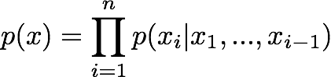
Fully visible belief network
Explicit density model
Use chain rule to decompose likelihood of an image x into product of 1-d distributions:
Likelihood of image x
Probability of i’th pixel value given all previous pixels
Then maximize likelihood of training data

Slide 12
Fully visible belief network
Explicit density model
Use chain rule to decompose likelihood of an image x into product of 1-d distributions:
Likelihood of image x
Probability of i’th pixel value given all previous pixels
Complex distribution over pixel
values => Express using a neural network!
Then maximize likelihood of training data
Lecture 13 -

Slide 13
Fully visible belief network
Explicit density model
Use chain rule to decompose likelihood of an image x into product of 1-d distributions:
Will need to define ordering of “previous pixels”
Likelihood of image x
Probability of i’th pixel value given all previous pixels
Complex distribution over pixel values => Express using a neural network!
Then maximize likelihood of training data
Lecture 13 -

Slide 14










PixelRNN
[van der Oord et al. 2016]
Generate image pixels starting from corner
Dependency on previous pixels modeled using an RNN (LSTM)
Lecture 13 -

Slide 15

PixelRNN
[van der Oord et al. 2016]
Generate image pixels starting from corner
Dependency on previous pixels modeled using an RNN (LSTM)
Lecture 13 -

Slide 16


PixelRNN
[van der Oord et al. 2016]
Generate image pixels starting from corner
Dependency on previous pixels modeled using an RNN (LSTM)
Lecture 13 -

Slide 17



PixelRNN
[van der Oord et al. 2016]
Generate image pixels starting from corner
Dependency on previous pixels modeled using an RNN (LSTM)
Drawback: sequential generation is slow!
Lecture 13 -

Slide 18
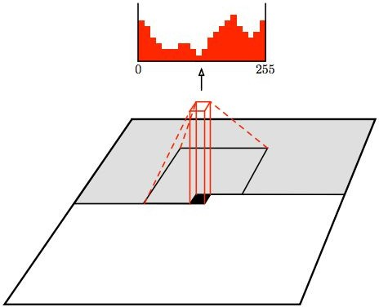
PixelCNN
[van der Oord et al. 2016]
Still generate image pixels starting from corner
Dependency on previous pixels now modeled using a CNN over context region
Figure copyright van der Oord et al., 2016. Reproduced with permission.
Lecture 13 -

Slide 19
PixelCNN
[van der Oord et al. 2016]
Softmax loss at each pixel
Still generate image pixels starting from corner
Dependency on previous pixels now modeled using a CNN over context region
Training: maximize likelihood of training images
Figure copyright van der Oord et al., 2016. Reproduced with permission.
Lecture 13 -

Slide 20
PixelCNN
[van der Oord et al. 2016]
Still generate image pixels starting from corner
Dependency on previous pixels now modeled using a CNN over context region
Training is faster than PixelRNN
(can parallelize convolutions since context region values known from training images)
Generation must still proceed sequentially
=> still slow
Figure copyright van der Oord et al., 2016. Reproduced with permission.
Lecture 13 -

Slide 21
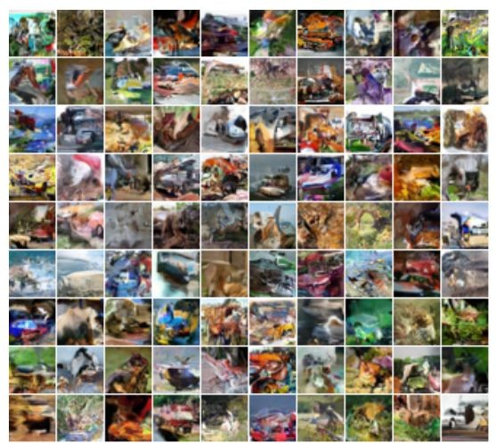
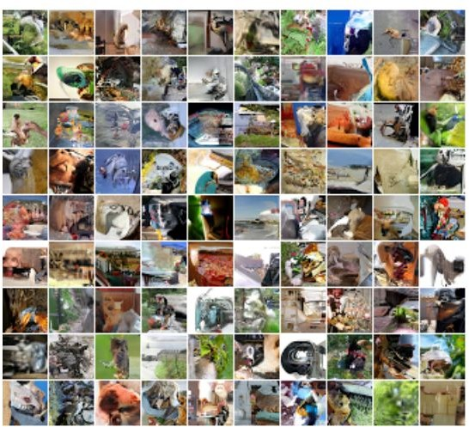
Generation Samples
32x32 CIFAR-10
32x32 ImageNet
Figures copyright Aaron van der Oord et al., 2016. Reproduced with permission.
Lecture 13 -

Slide 22
Autoencoders and Variational Autoencoders (VAE)

Slide 23
Autoencoders
Autoencoders are a specific type of feedforward neural networks where the input is the same as the output.
They compress the input into a lower-dimensional code and then reconstruct the output from this representation.
The code is a compact “summary” or “compression” of the input, also called the latent-space representation.

Slide 24
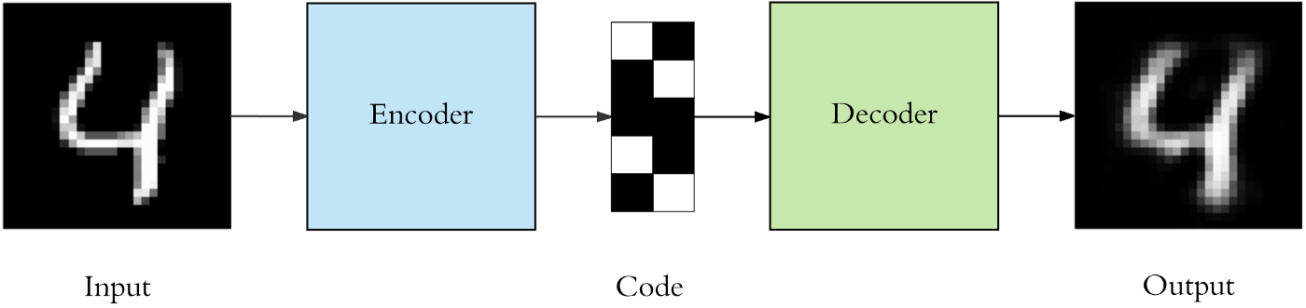
Autoencoder
To build an autoencoder we need 3 things: an encoding method, decoding method, and a loss function to compare the output with the target.
An autoencoder consists of 3 components: encoder, code and decoder. The encoder compresses the input and produces the code, the decoder then reconstructs the input only using this code.

Slide 25
Autoencoder
Autoencoders are mainly a dimensionality reduction (or compression) algorithm with a couple of important properties:
Data-specific: Autoencoders are only able to meaningfully compress data similar to what they have been trained on. So we can’t expect an autoencoder trained on handwritten digits to compress landscape photos.
Lossy: The output of the autoencoder will not be exactly the same as the input, it will be a close but degraded representation. If you want lossless compression they are not the way to go.
Unsupervised: Autoencoders are considered an unsupervised learning technique since they don’t need explicit labels to train on. But to be more precise they are self-supervised because they generate their own labels from the training data.

Slide 26
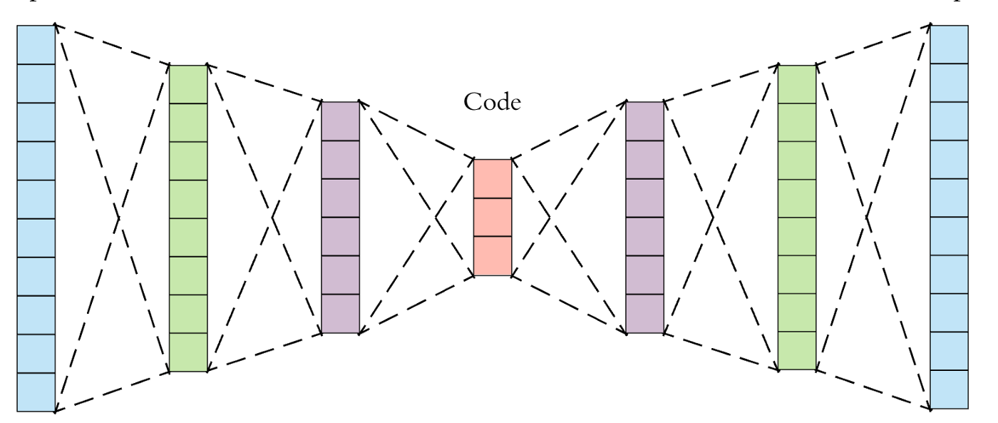
Autoencoder architecture

Slide 27
Applications of Autoencoders
Dimensionality Reduction
Image Compression
Image Denoising
Feature Extraction
Image generation
Sequence to sequence prediction
Recommendation system

Slide 28
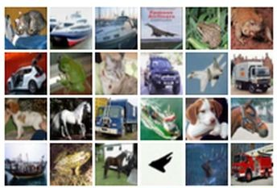
Autoencoders
Unsupervised approach for learning a lower-dimensional feature representation from unlabeled training data
Features
Encoder
Input data
Lecture 13 -

Slide 29
Autoencoders
Unsupervised approach for learning a lower-dimensional feature representation from unlabeled training data
Originally: Linear + nonlinearity (sigmoid)
Later: Deep, fully-connected
Later: ReLU CNN
Features
Encoder
Input data
Lecture 13 -

Slide 30
Autoencoders
Unsupervised approach for learning a lower-dimensional feature representation from unlabeled training data
z usually smaller than x
(dimensionality reduction)
Originally: Linear + nonlinearity (sigmoid)
Later: Deep, fully-connected
Later: ReLU CNN
Q: Why dimensionality reduction?
A: Want features to capture meaningful factors of variation in data
Features
Encoder
Input data
Lecture 13 -

Slide 31
Autoencoders
How to learn this feature representation?
Train such that features can be used to reconstruct original data “Autoencoding” - encoding itself
Originally: Linear +
nonlinearity (sigmoid)
Later: Deep, fully-connected
Later: ReLU CNN (upconv)
Reconstructed input data
Decoder
Features
Encoder
Input data
Lecture 13 -

Slide 32
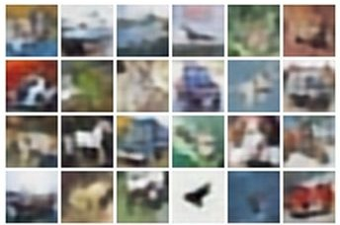
Autoencoders
Reconstructed data
How to learn this feature representation?
Train such that features can be used to reconstruct original data “Autoencoding” - encoding itself
Reconstructed input data
Encoder: 4-layer conv
Decoder: 4-layer upconv
Decoder
Input data
Features
Encoder
Input data
Lecture 13 -

Slide 33
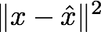
Autoencoders
Reconstructed data
Train such that features
can be used to reconstruct original data
L2 Loss function:
Decoder res
 | Encoder
Reconstructed input data
Encoder: 4-layer conv
Decoder: 4-layer upconv
Input data
Featu
Input data
Lecture 13 -

Slide 34
Autoencoders
Reconstructed data
Train such that features can be used to reconstruct original data
Doesn’t use labels!
L2 Loss function:
Decoder res
 | Encoder
Reconstructed input data
Featu
Encoder: 4-layer conv
Decoder: 4-layer upconv
Input data
Input data
Lecture 13 -

Slide 35
Autoencoders
Reconstructed input data
Decoder
Features
After training,
throw away decoder
Encoder
Input data
Lecture 13 -

Slide 36
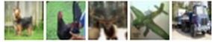
Autoencoders
Loss function (Softmax, etc)
bird
plane
dog
deer
truck
Predicted Label
Fine-tune encoder jointly with classifier
Train for final task (sometimes with small data)
Classifier
Encoder can be used to initialize a supervised model
Features
Encoder
Input data
Lecture 13 -

Slide 37
Autoencoders
Autoencoders can reconstruct data, and can learn features to initialize a supervised model
Reconstructed input data
Features capture factors of variation in training data. Can we generate new images from an autoencoder?
Decoder
Features
Encoder
Input data
Lecture 13 -

Slide 38
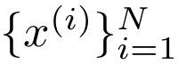
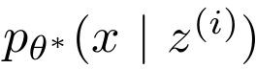
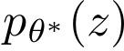
Variational Autoencoders
Probabilistic spin on autoencoders - will let us sample from the model to generate data!
Assume training data is generated from underlying unobserved (latent) representation z
Sample from true conditional
Sample from true prior
Kingma and Welling, “Auto-Encoding Variational Bayes”, ICLR 2014
Lecture 13 -

Slide 39
Variational Autoencoders
Probabilistic spin on autoencoders - will let us sample from the model to generate data!
Assume training data is generated from underlying unobserved (latent) representation z
Intuition (remember from autoencoders!): x is an image, z is latent factors used to generate x: attributes, orientation, etc.
Sample from true conditional
Sample from true prior
Kingma and Welling, “Auto-Encoding Variational Bayes”, ICLR 2014
Lecture 13 -

Slide 40
Variational Autoencoders
We want to estimate the true parameters of this generative model.
Sample from true conditional
How should we represent this model?
Choose prior p(z) to be simple, e.g. Gaussian. Reasonable for latent attributes,
e.g. pose, how much smile.
Sample from true prior
Kingma and Welling, “Auto-Encoding Variational Bayes”, ICLR 2014
Lecture 13 -

Slide 41
Variational Autoencoders
We want to estimate the true parameters of this generative model.
Sample from true conditional
How should we represent this model?
Choose prior p(z) to be simple, e.g. Gaussian.
Conditional p(x|z) is complex (generates image) => represent with neural network
Decoder network
Sample from true prior
Kingma and Welling, “Auto-Encoding Variational Bayes”, ICLR 2014
Lecture 13 -

Slide 42
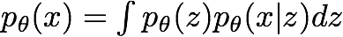
Variational Autoencoders
We want to estimate the true parameters of this generative model.
Sample from true conditional
How to train the model?
Learn model parameters to maximize likelihood of training data
Decoder network
Sample from true prior
Kingma and Welling, “Auto-Encoding Variational Bayes”, ICLR 2014
Lecture 13 -

Slide 43
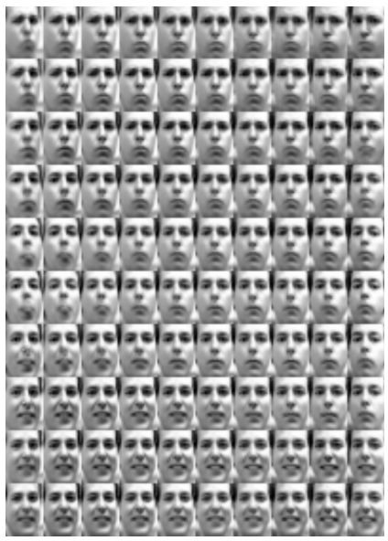
Variational Autoencoders: Generating Data!
Diagonal prior on z
=> independent latent variables
Degree of smile
Different dimensions of z encode interpretable factors of variation
Vary z₁
Head pose
Kingma and Welling, “Auto-Encoding Variational Bayes”, ICLR 2014
Vary z₂
Lecture 13 -

Slide 44

Variational Autoencoders: Generating Data!
Diagonal prior on z
=> independent latent variables
Degree of smile
Different dimensions of z encode interpretable factors of variation
Vary z₁
Also good feature representation that can be computed using q_{ɸ}(z|x)!
Kingma and Welling, “Auto-Encoding Variational Bayes”, ICLR 2014
Head pose
Vary z
2
Lecture 13 -
95

Slide 45
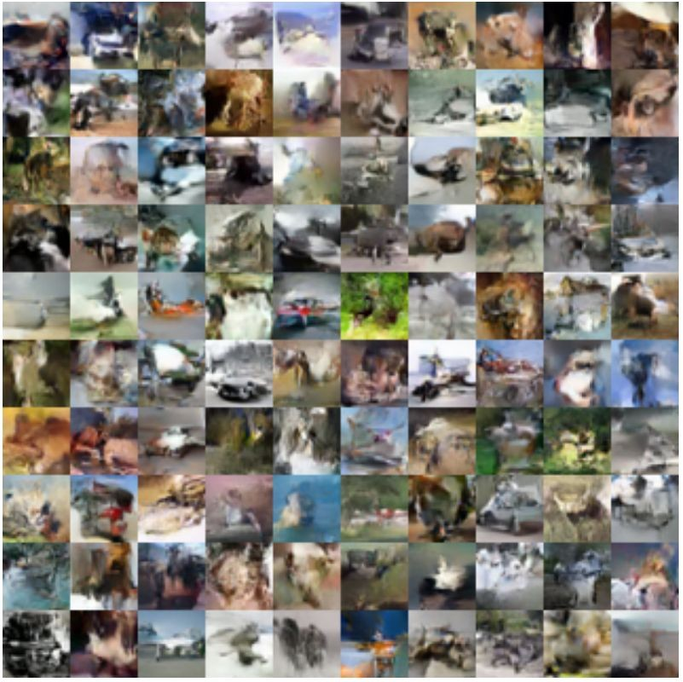
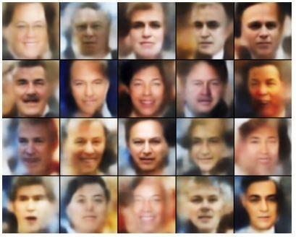
Variational Autoencoders: Generating Data!
Labeled Faces in the Wild
32x32 CIFAR-10
Figures copyright (L) Dirk Kingma et al. 2016; (R) Anders Larsen et al. 2017. Reproduced with permission.
Lecture 13 -

Slide 46
Generative Adversarial Networks (GAN)

Slide 47
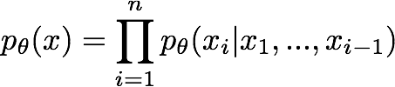
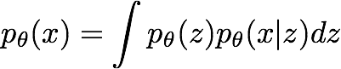
So far...
PixelCNNs define tractable density function, optimize likelihood of training data:
VAEs define intractable density function with latent z:
Cannot optimize directly, derive and optimize lower bound on likelihood instead What if we give up on explicitly modeling density, and just want ability to sample?
GANs: don’t work with any explicit density function!
Instead, take game-theoretic approach: learn to generate from training distribution through 2-player game
Lecture 13 -

Slide 48
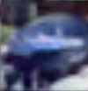
Generative Adversarial Networks
Ian Goodfellow et al., “Generative Adversarial Nets”, NIPS 2014
Problem: Want to sample from complex, high-dimensional training distribution. No direct way to do this!
Solution: Sample from a simple distribution, e.g. random noise. Learn transformation to training distribution.
Q: What can we use to represent this complex transformation?
Output: Sample from training distribution
A: A neural network!
Generator Network
Input: Random noise
z
Lecture 13 -

Slide 49
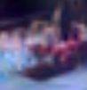
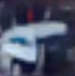
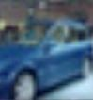
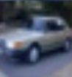
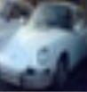
Training GANs: Two-player game
Ian Goodfellow et al., “Generative Adversarial Nets”, NIPS 2014
Generator network: try to fool the discriminator by generating real-looking images
Discriminator network: try to distinguish between real and fake images
Real or Fake
Discriminator Network
Fake Images (from generator)
Real Images (from training set)
Generator Network
Random noise
z
Fake and real images copyright Emily Denton et al. 2015. Reproduced with permission.
Lecture 13 -

Slide 50
Training GANs: Two-player game
Ian Goodfellow et al., “Generative Adversarial Nets”, NIPS 2014
Generator network: try to fool the discriminator by generating real-looking images
Discriminator network: try to distinguish between real and fake images
Train jointly in minimax game
Minimax objective function:
Lecture 13 -

Slide 51
Training GANs: Two-player game
Ian Goodfellow et al., “Generative Adversarial Nets”, NIPS 2014
Generator network: try to fool the discriminator by generating real-looking images
Discriminator network: try to distinguish between real and fake images
Train jointly in minimax game
Discriminator outputs likelihood in (0,1) of real image
Minimax objective function:
Discriminator output for real data x
Discriminator output for generated fake data G(z)
Lecture 13 -

Slide 52
Training GANs: Two-player game
Ian Goodfellow et al., “Generative Adversarial Nets”, NIPS 2014
Generator network: try to fool the discriminator by generating real-looking images
Discriminator network: try to distinguish between real and fake images
Train jointly in minimax game
Discriminator outputs likelihood in (0,1) of real image
Minimax objective function:
Discriminator output for real data x
Discriminator output for generated fake data G(z)
Discriminator (θ_{d}) wants to maximize objective such that D(x) is close to 1 (real) and D(G(z)) is close to 0 (fake)
Generator (θ_{g}) wants to minimize objective such that D(G(z)) is close to 1 (discriminator is fooled into thinking generated G(z) is real)
Lecture 13 -

Slide 53
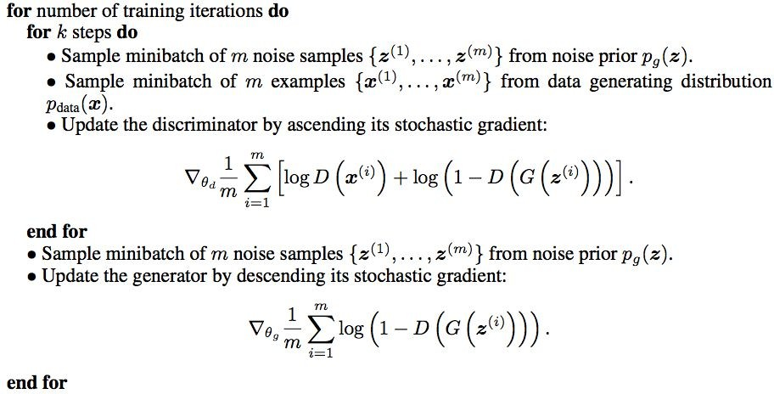
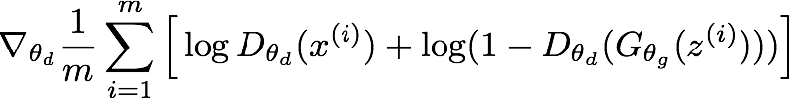
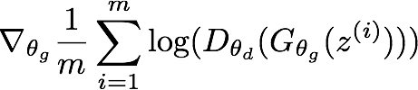
Training GANs: Two-player game
Ian Goodfellow et al., “Generative Adversarial Nets”, NIPS 2014
Putting it together: GAN training algorithm
Lecture 13 -

Slide 54
Training GANs: Two-player game
Ian Goodfellow et al., “Generative Adversarial Nets”, NIPS 2014
Putting it together: GAN training algorithm
Some find k=1 more stable, others use k > 1, no best rule.
Recent work (e.g. Wasserstein GAN) alleviates this problem, better stability!
Lecture 13 -

Slide 55
Training GANs: Two-player game
Ian Goodfellow et al., “Generative Adversarial Nets”, NIPS 2014
Generator network: try to fool the discriminator by generating real-looking images
Discriminator network: try to distinguish between real and fake images
Real or Fake
Discriminator Network
Fake Images (from generator)
Random noise
Real Images (from training set)
Generator Network
After training, use generator network to generate new images
z
Fake and real images copyright Emily Denton et al. 2015. Reproduced with permission.
Lecture 13 -

Slide 56
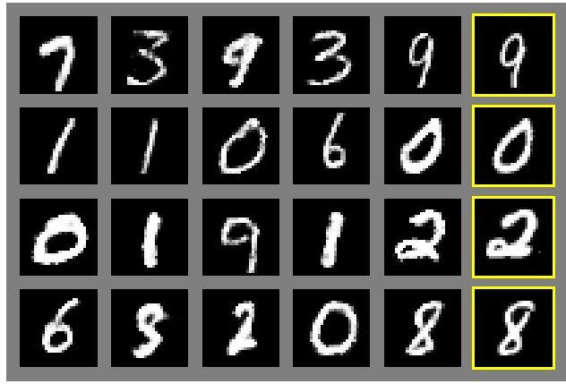
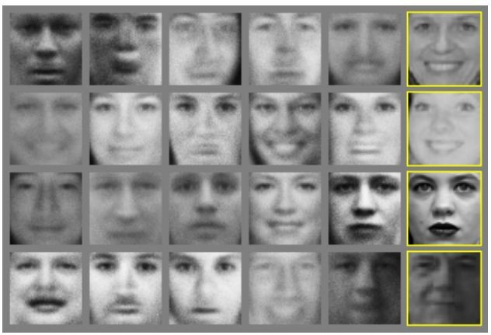
Ian Goodfellow et al., “Generative Adversarial Nets”, NIPS 2014
Generative Adversarial Nets
Generated samples
Nearest neighbor from training set
Fei-Fei Li & Justin Johnson & Serena Yeung
Figures copyright Ian Goodfellow et al., 2014. Reproduced with permission.
Lecture 13 -

Slide 57
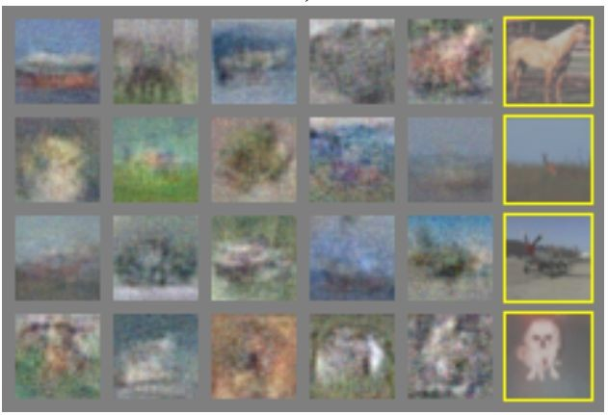
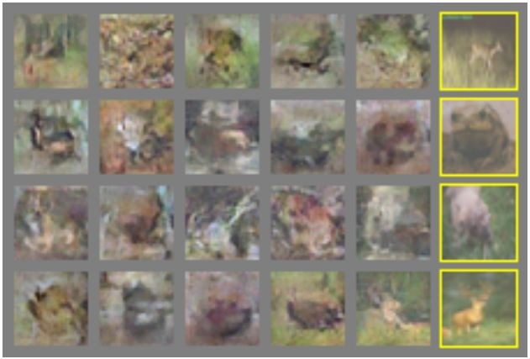
Ian Goodfellow et al., “Generative Adversarial Nets”, NIPS 2014
Generative Adversarial Nets
Generated samples (CIFAR-10)
Nearest neighbor from training set
Fei-Fei Li & Justin Johnson & Serena Yeung
Figures copyright Ian Goodfellow et al., 2014. Reproduced with permission.
Lecture 13 -

Slide 58
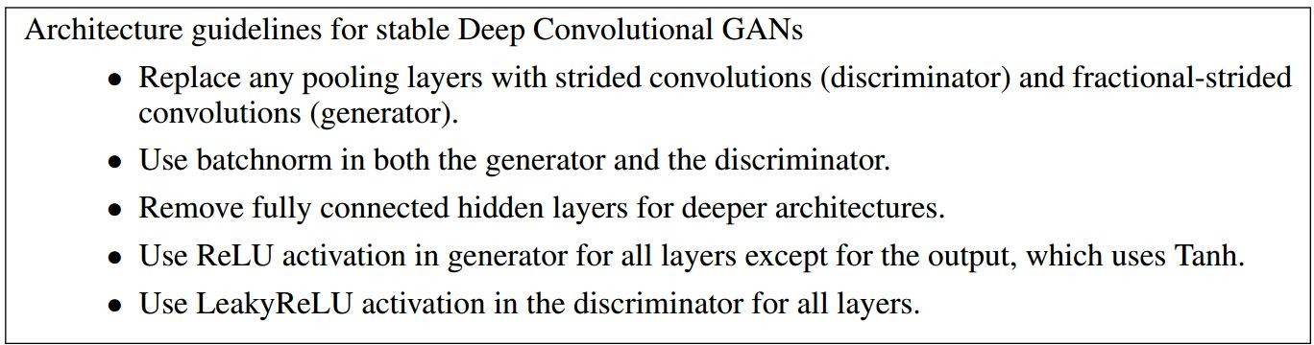
Generative Adversarial Nets: Convolutional Architectures
Generator is an upsampling network with fractionally-strided convolutions Discriminator is a convolutional network
Radford et al, “Unsupervised Representation Learning with Deep Convolutional Generative Adversarial Networks”, ICLR 2016
Lecture 13 -

Slide 59

Generative Adversarial Nets: Convolutional Architectures
Generator
Radford et al, “Unsupervised Representation Learning with Deep Convolutional Generative Adversarial Networks”, ICLR 2016
Lecture 13 -

Slide 60

Generative Adversarial Nets: Convolutional Architectures
Samples from the model look amazing!
Radford et al, ICLR 2016
12
0
Lecture 13 -

Slide 61

Generative Adversarial Nets: Convolutional Architectures
Interpolating between random points in late space
nt
Radford et al, ICLR 2016
12
1
Lecture 13 -

Slide 62

Generative Adversarial Nets: Interpretable Vector Math
Smiling woman Neutral woman Neutral man
Radford et al, ICLR 2016
Samples from the model
Lecture 13 -

Slide 63

Generative Adversarial Nets: Interpretable Vector Math
Smiling woman Neutral woman Neutral man
Radford et al, ICLR 2016
Samples from the model
Average Z
vectors, do arithmetic
Lecture 13 -

Slide 64

Generative Adversarial Nets: Interpretable Vector Math
Smiling woman Neutral woman Neutral man
Radford et al, ICLR 2016
Smiling Man
Samples from the model
Average Z
vectors, do arithmetic
Lecture 13 -

Slide 65

Generative Adversarial Nets: Interpretable Vector Math
Glasses man No glasses man No glasses woman
Radford et al, ICLR 2016
Lecture 13 -

Slide 66

Generative Adversarial Nets: Interpretable Vector Math
Glasses man No glasses man No glasses woman
Radford et al, ICLR 2016
Woman with glasses
Lecture 13 -

Slide 67








2017: Year of the GAN
Better training and generation Source->Target domain transfer
Text -> Image Synthesis
Reed et al. 2017.
Many GAN applications
LSGAN. Mao et al. 2017.
Pix2pix. Isola 2017. Many examples at https://phillipi.github.io/pix2pix/
CycleGAN. Zhu et al. 2017.
BEGAN. Bertholet et al. 2017.
Lecture 13 -

Slide 68

References
http://cs231n.stanford.edu/slides/2017/cs231n_2017_lecture13.pdf

